Slide 1
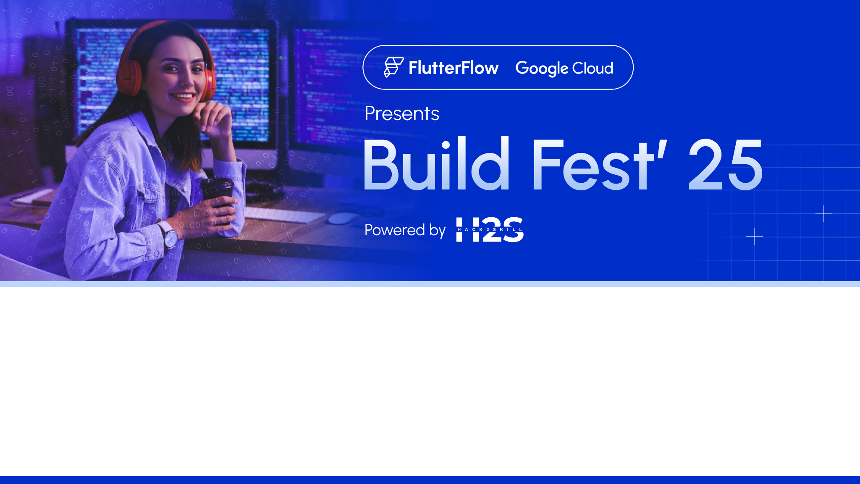
Team Name : Narrative IQ
Team Leader Name : Jaskirat Singh
Theme: Narrative Dashboard: Interactive AI-Generated Business Reports

Slide 2
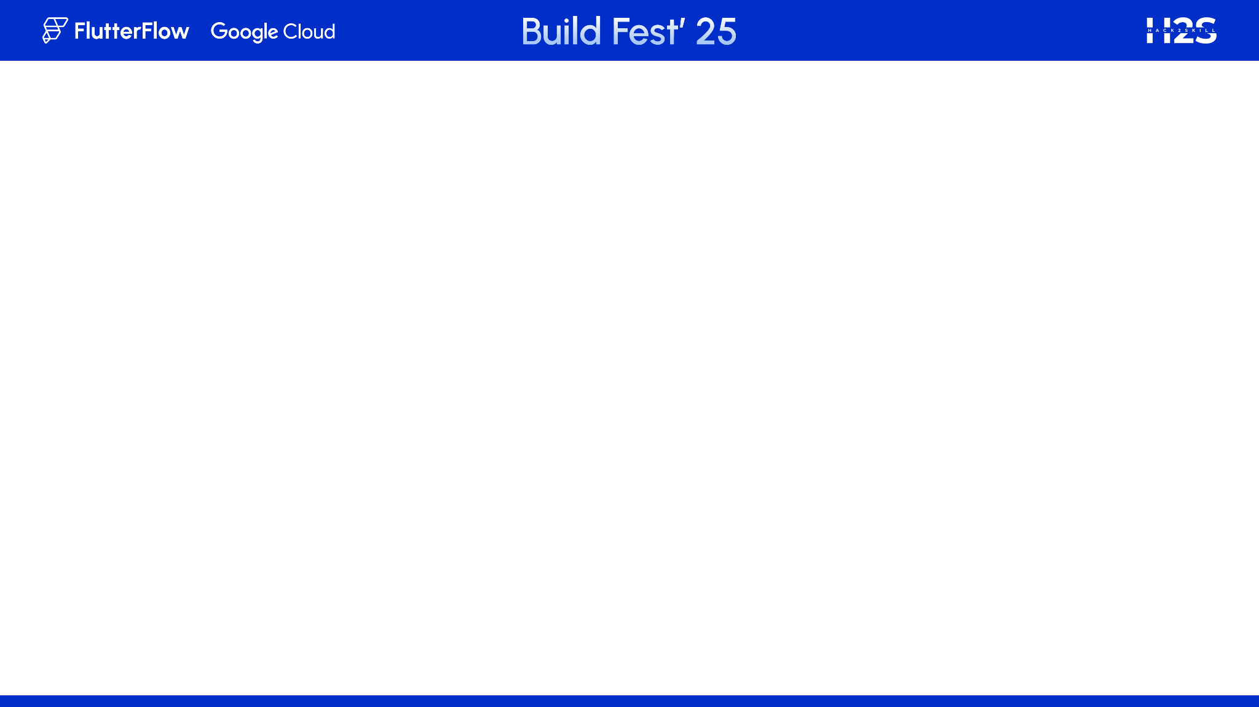
Brief about the Idea:
The Narrative IQ redefines how businesses consume data by using Generative Artificial Intelligence to create dynamic, story-like business reports in real time.
🔄 Unlike static BI tools, this dashboard generates automated narratives using foundational AI models.
🧠 Foundational models ensure adaptability across domains (like finance, marketing, sports, healthcare) with natural language explanations.
🚀 This dramatically reduces the time needed for decision-makers to extract insights.
How is it different?
Combines Gen AI with traditional dashboards
Narratives evolve as data updates
No manual data slicing required
USP
Smart, data-driven storytelling with zero manual report writing.

Slide 3
List of features offered by the solution
📜 1. AI-Generated Narrative Reports
Foundational models generate real-time, contextual business narratives from raw data.
Removes the need for manual interpretation of graphs.
📊 2. Interactive Dashboard Panels
Dynamic data visualizations (charts, KPIs) synced with narrative explanations.
🧠 3. Integration with Foundational AGI Models
Uses transformer-based models for generating rich natural language summaries.
Enables human-like storytelling from structured business data.
🗂 4. Historical Report Archive
Stores previous reports for comparison over time.
🔍 5. Trend & Anomaly Detection
Highlights significant changes or patterns in data.

Slide 4

Process flow diagram or Use-case diagram

Slide 5
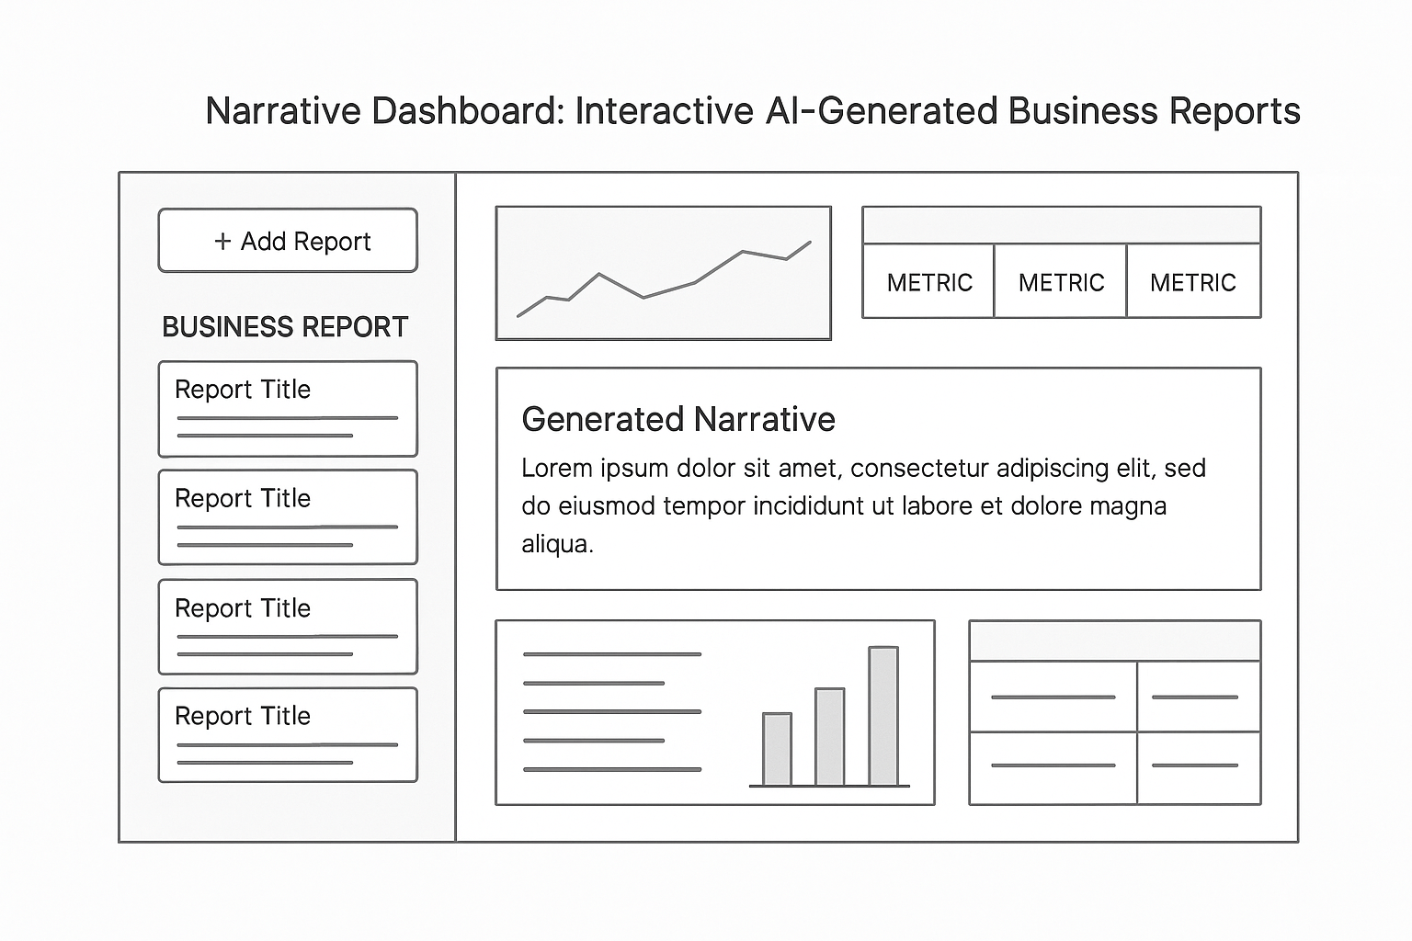
Wireframes/Mock diagrams of the proposed solution (optional)

Slide 6
Technologies used in the solution:
🧠 Artificial Generative Intelligence (AGI)
Utilizes foundational models (e.g., GPT-style architectures such as Gemini 1.5 Flash) to generate natural language reports.
Provides context-aware, human-like summaries based on data input.
🐍 Python + Flask (Backend)
Manages data flow, AGI integration, and API endpoints.
Lightweight and scalable web framework ideal for rapid prototyping.
🗃️ SQLite (Database)
Stores user reports, titles, timestamps, and narrative content.
Simple, file-based relational database — ideal for lightweight apps.
🌐 HTML, CSS, JavaScript (Frontend)
Presents an interactive, real-time dashboard interface.
Supports dynamic content rendering and report visualization.
📊 Data Visualization Library
Using chart.js (Visualization Library) which enables rich, interactive charts (e.g., line graphs, bar charts) for visualizing key metrics and trends.
☁️ Cloud Deployment Infrastructure
Using GCP for scalable, serverless deployment of Flask app.
⚙️ CI/CD & Containerization
Used docker (Containerization) which ensures consistent runtime environment for development, testing, and cloud deployment.

Slide 7
Estimated implementation cost:
🚀 Deployment Phase (Cloud-Based, Scalable)
💡 Prototype Phase (Local/Test Environment)
Item | Cost Estimate (USD)
Flask Web App (Open Source) | $0
SQLite Database (Built-in) | $0
Hosting on Local Machine | $0
Foundational Model API (Free Tier) | $0
Basic UI Design (Templates + CSS) | $0
Total | $0
Item | Cost Estimate (USD/month)
Cloud Hosting (i.e., GCP) and containerization (i.e., Docker) | $0
Database Hosting | $0
Foundational Model API (e.g., Gemini 1.5 Flash) | $0
Total Monthly (approx.) | $0

Slide 8
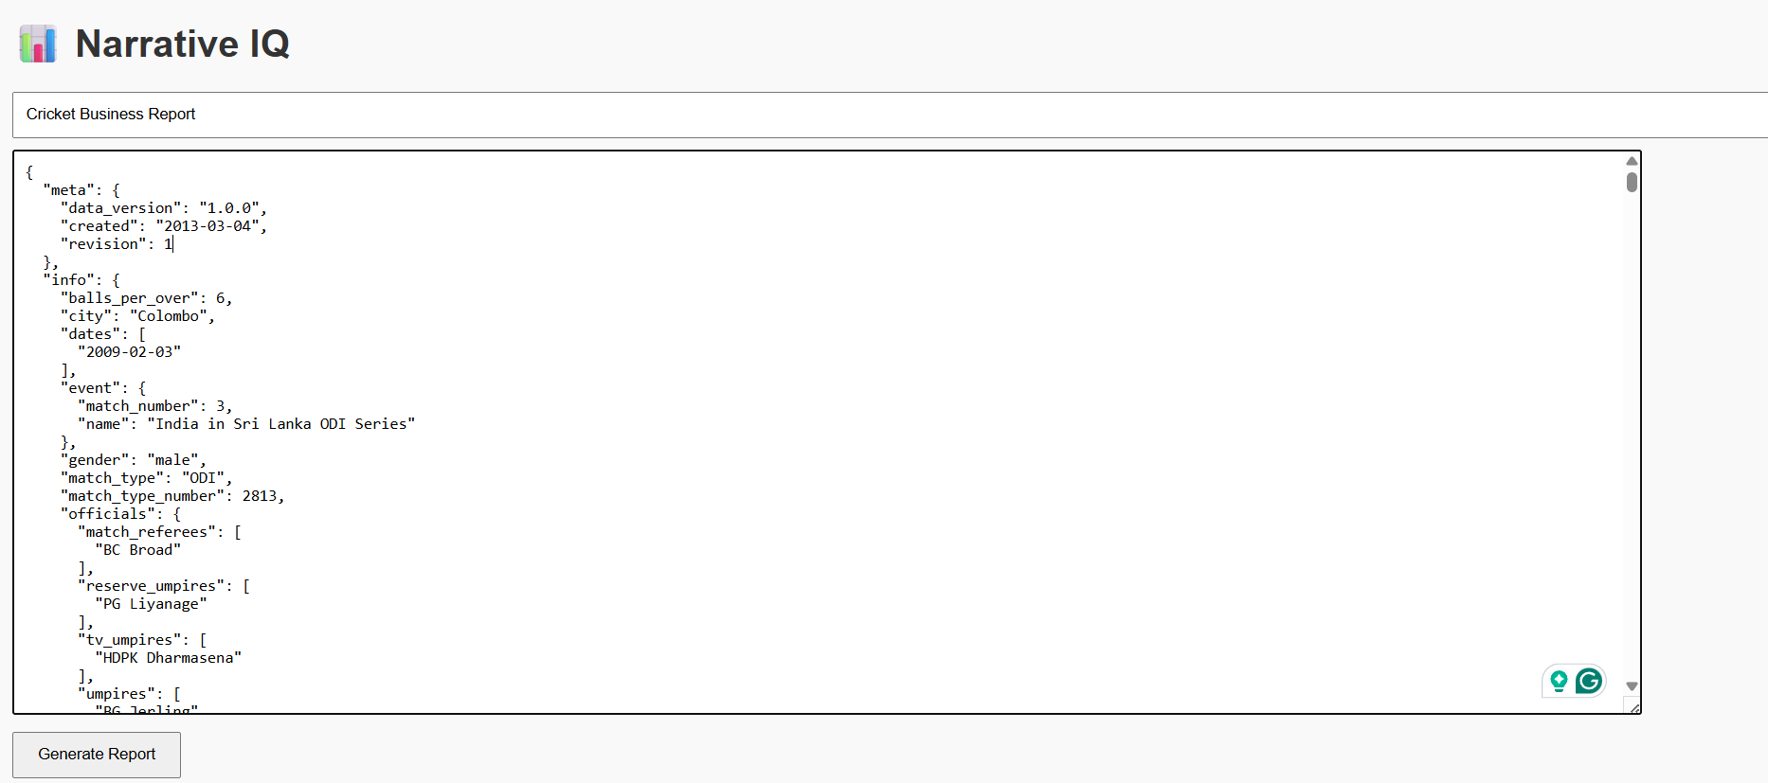
Snapshots of the App

Slide 9
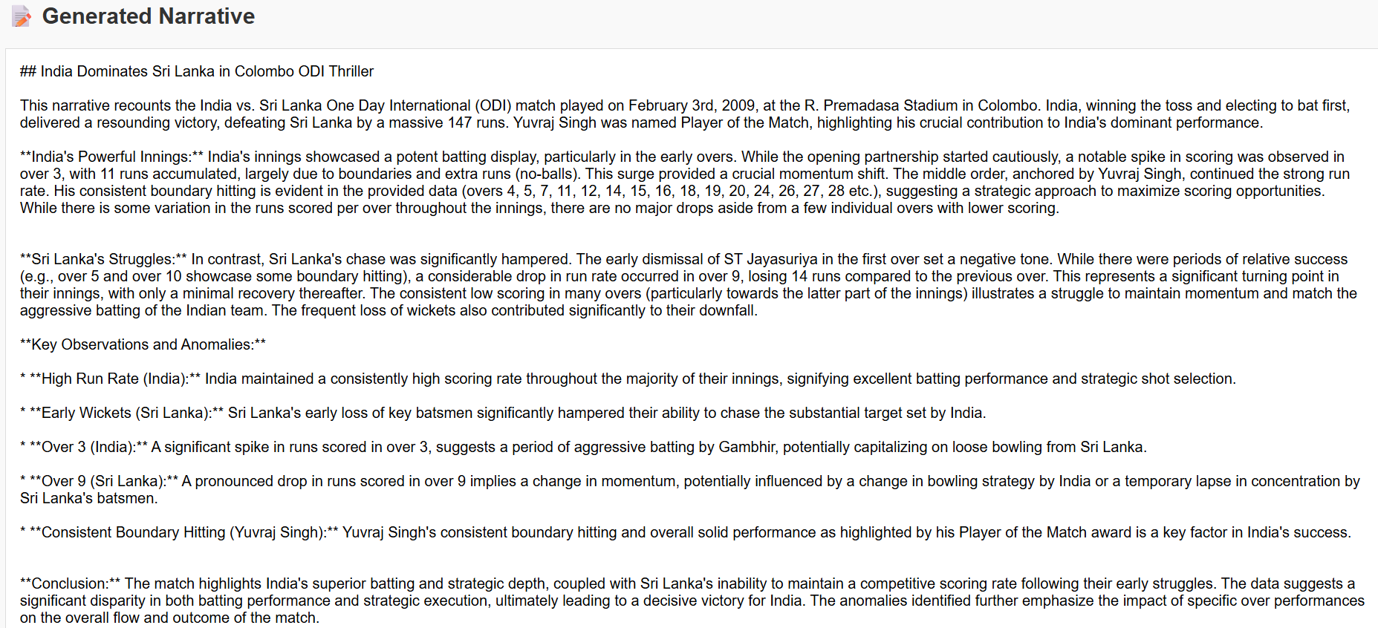
Snapshots of the App

Slide 10
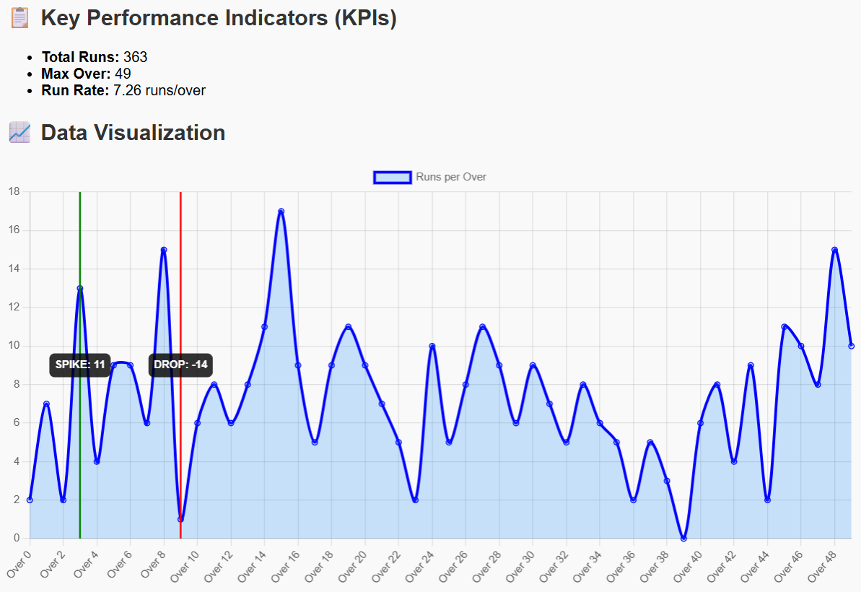
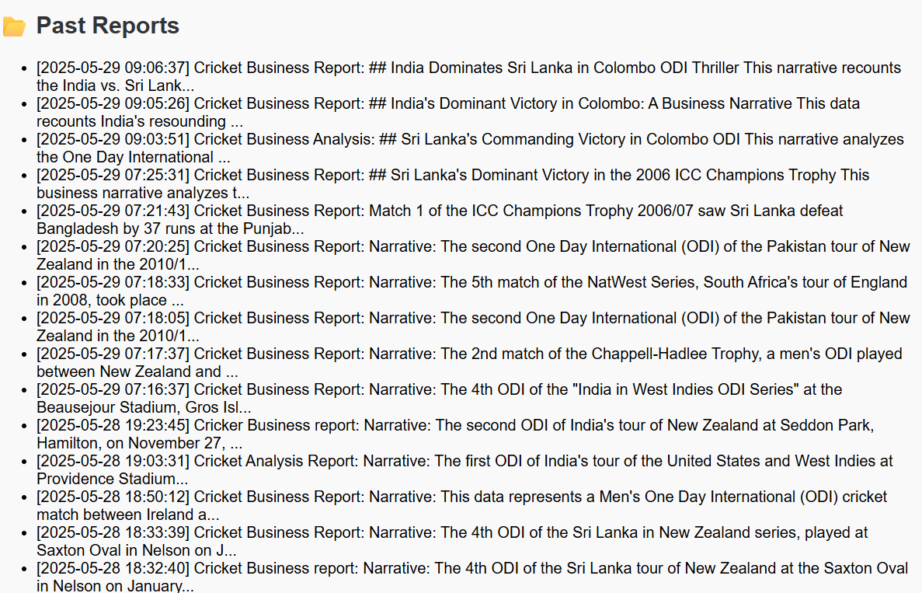
Snapshots of the App

Slide 11
Future development & scope of the App
🔐 1. User Authentication & Access Control
Implement secure logins, user roles, and personalized dashboards.
Enable role-specific views and edit permissions for reports.
🤖 2. Real-Time AGI Integration
Connect directly to advanced foundational models (e.g., Gemini).
Allow live querying of data with AI-generated analysis.
☁️ 3. Scalable Cloud Deployment
Migrate to cloud platforms (AWS, Azure, GCP) for global accessibility.
Support concurrent users, auto-scaling, and robust uptime.
📱 4. Mobile App Development
Launch mobile-friendly interfaces (PWA or native app).
Push real-time alerts and reports on-the-go.
📊 5. Multi-Source Data Integration
Plug into CRMs, ERPs, and cloud storage for richer datasets.
Automate ETL pipelines to keep data updated continuously.
🌍 6. Multilingual Narrative Support
Enable business reports in global languages.
Use translation models for cross-border reporting.
🧩 7. Plugin Ecosystem & AI Marketplace
Allow third-party AI features: sentiment analysis, predictive modelling, etc.
Create a marketplace of AGI-powered business plugins.

Slide 12


